Slide 1
16 Mark Preparation lesson
3. Was the opposition of business interests the main problem Roosevelt faced in carrying out his New Deal reforms? Explain your answer.
You may use the following in your answer and any other information of your own.
The opposition of business interests
The supreme court
The Republicans
Huey Long

Slide 2
16 mark questions
25 minutes
You get up to an extra 4 marks for SPAG (spelling, punctuation/grammar)
Two bullet points are included for hints; you must also include information of your own (please note I am including a sheet today with Question 3s that have 4 bullet points but that is because the expectations have changed)
To gain the highest marks, you must show links between factors, make judgements on the importance of each factor and come to a conclusion

Slide 3
The Opposition of Business Interests
P
E
E
The Republicans
P
E
E
3. Was the opposition of business interests the main problem Roosevelt faced in carrying out his New Deal reforms? Explain your answer
The Supreme Court
P
E
E
Huey Long
P
E
E

Slide 4
The Opposition of Business Interests
P
E
E
The Republicans
P
E
E
Judgement
3. Was the opposition of business interests the main problem Roosevelt faced in carrying out his New Deal reforms? Explain your answer
The Supreme Court
P
E
E
Huey Long
P
E
E

Slide 5
Mark Scheme
Level 1 Simple or generalised statements of causation. Makes statements which lack any
supporting knowledge. E.g. The position of women now changed their lives
Level 2 Developed statements of causation.
• 4–5 marks for developing one cause.
• 5–6 marks for developing two causes.
• 6–7 marks for developing three causes. E.g. One cause was the change in the position of women. In the northern states women known as ‘flappers’ took a free approach to their behaviour and appearance
Level 3 Developed explanation of causation.
Developed explanation of causation, agreeing and/or disagreeing with the question.
• 8–9 marks for one cause explained.
• 9–10 marks for two causes explained.
• 11-12 marks for three or more causes explained.
Maximum 10 marks for answers that do not explain another cause besides the ones given One cause was
the change in the position of women. In the northern states women known as ‘flappers’ took a free
approach to their behaviour and appearance. This caused lives of women to improve as they became
more independent but challenging societies traditional values
Level 4 Prioritises causes or makes links between them
13–14 marks for judgement on relative importance of two causes.
15–16 marks for judgement on relative importance of more than two causes or for an
answer which shows the interrelationship between three causes in coming to a
judgment. or for illustrating that one ‘most important’ cause on its own could not
provide a satisfactory explanation.

Slide 6
Intro – should be short and only answer the question

Slide 7
P – It can be argued that the New Deal faced a lot of opposition from business. E – Many businesses genuinely resented the reforms introduced by the NRA that forced businesses to adopt codes of practice, what more imposed fines on businesses that broke those laws. E - This caused a lot of opposition since most business still considered the laissez faire approach to be a valid form of business conduct and viewed any interference with the way they were operating as un-American.

Slide 8
Paragraph sentence starter
One example of who opposed businesses was ……
The evidence for this is………….
This caused a lot of opposition because………………..
X3

Slide 9
Mark Scheme
Level 1 Simple or generalised statements of causation. Makes statements which lack any
supporting knowledge. E.g. There was lots of opposition to the New Deal
Level 2 Developed statements of causation.
• 4–5 marks for developing one cause.
• 5–6 marks for developing two causes.
• 6–7 marks for developing three causes or more. E.g. It can be argued that the New Deal faced a lot of opposition from business. E – Many businesses genuinely resented the reforms introduced by the NRA that forced businesses to adopt codes of practice, what more imposed fines on businesses that broke those laws.
Level 3 Developed explanation of causation.
Developed explanation of causation, agreeing and/or disagreeing with the question.
• 8–9 marks for one cause explained.
• 9–10 marks for two causes explained.
• 11-12 marks for three or more causes explained.
Maximum 10 marks for answers that do not explain another cause besides the ones given. It can be argued that the New Deal faced a lot of opposition from business. E – Many businesses genuinely resented the reforms introduced by the NRA that forced businesses to adopt codes of practice, what more imposed fines on businesses that broke those laws. E - This caused a lot of opposition since most business still considered the laissez faire approach to be a valid form of business conduct and viewed any interference with the way they were operating as un-American.
Level 4 Prioritises causes or makes links between them
13–14 marks for judgement on relative importance of two causes.
15–16 marks for judgement on relative importance of more than two causes or for an answer which shows the interrelationship between three causes in coming to a judgment. or for illustrating that one ‘most important’ cause on its own could not provide a satisfactory explanation.

Slide 10
To help you make links between causes
identify the points they have in common
link these points using connectives
similarly
in a similar way
equally
like
likewise
compared with
as with
The Supreme Court ruled against…
Big business was opposed to…

Slide 11
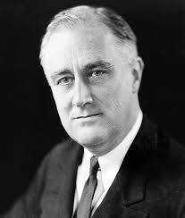
To help you make links between causes
identify where the opposition hold different views from each other
link these points using connectives
whereas
instead of
alternatively
but
otherwise
unlike
on the other hand
in contrast
Huey Long
wanted
MORE TAX!
doesn’t like
Big business
wanted
LESS TAX!

Slide 12
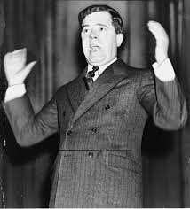
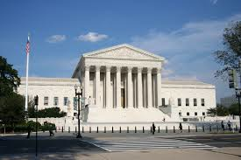
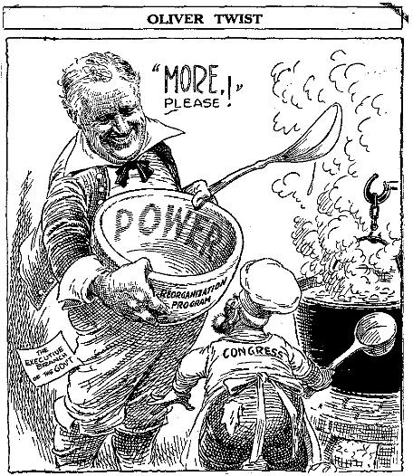
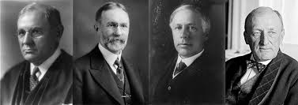
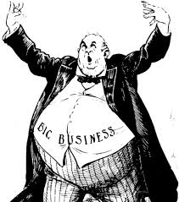
I was disappointed by the slow pace of reform and in 1934 I established the ‘Share Our Wealth Society’. I promised every family an allowance of $5000 and a minimum income of $2500. This was to be paid for by taxation of the rich and the confiscation of fortunes over $5 million.
We opposed FDR by ruling some of his measures unconstitutional because we felt they infringed on states’ rights and contravened the constitution.
We believed in ‘laissez-faire’ policies. We opposed tax payers’ money being used to help the poor and unemployed.
Big business opposed FDR because we felt threatened by government regulation and the rise of the unions. We campaigned against the Public Utility Holding Act and the Wagner Act
Political Opposition

